Slide 1

Mini Project-I (K24MCA18P) Odd Semester Session 2024-25
Recipe Finder
Piyush Jain 2426mca188
Samay Verma 2426mca699
Namrata Singh 2426mca680
Project Supervisor:
Ms. Divya Singhal
Assistant Professor

Slide 2
Content
Introduction
Literature Review
Objective of the Project
Technology
Hardware Requirements
Software Requirements
Modules
Workflow
Reports
References
Notes:
Font Styles: Times New Roman + Font Size: 25

Slide 3
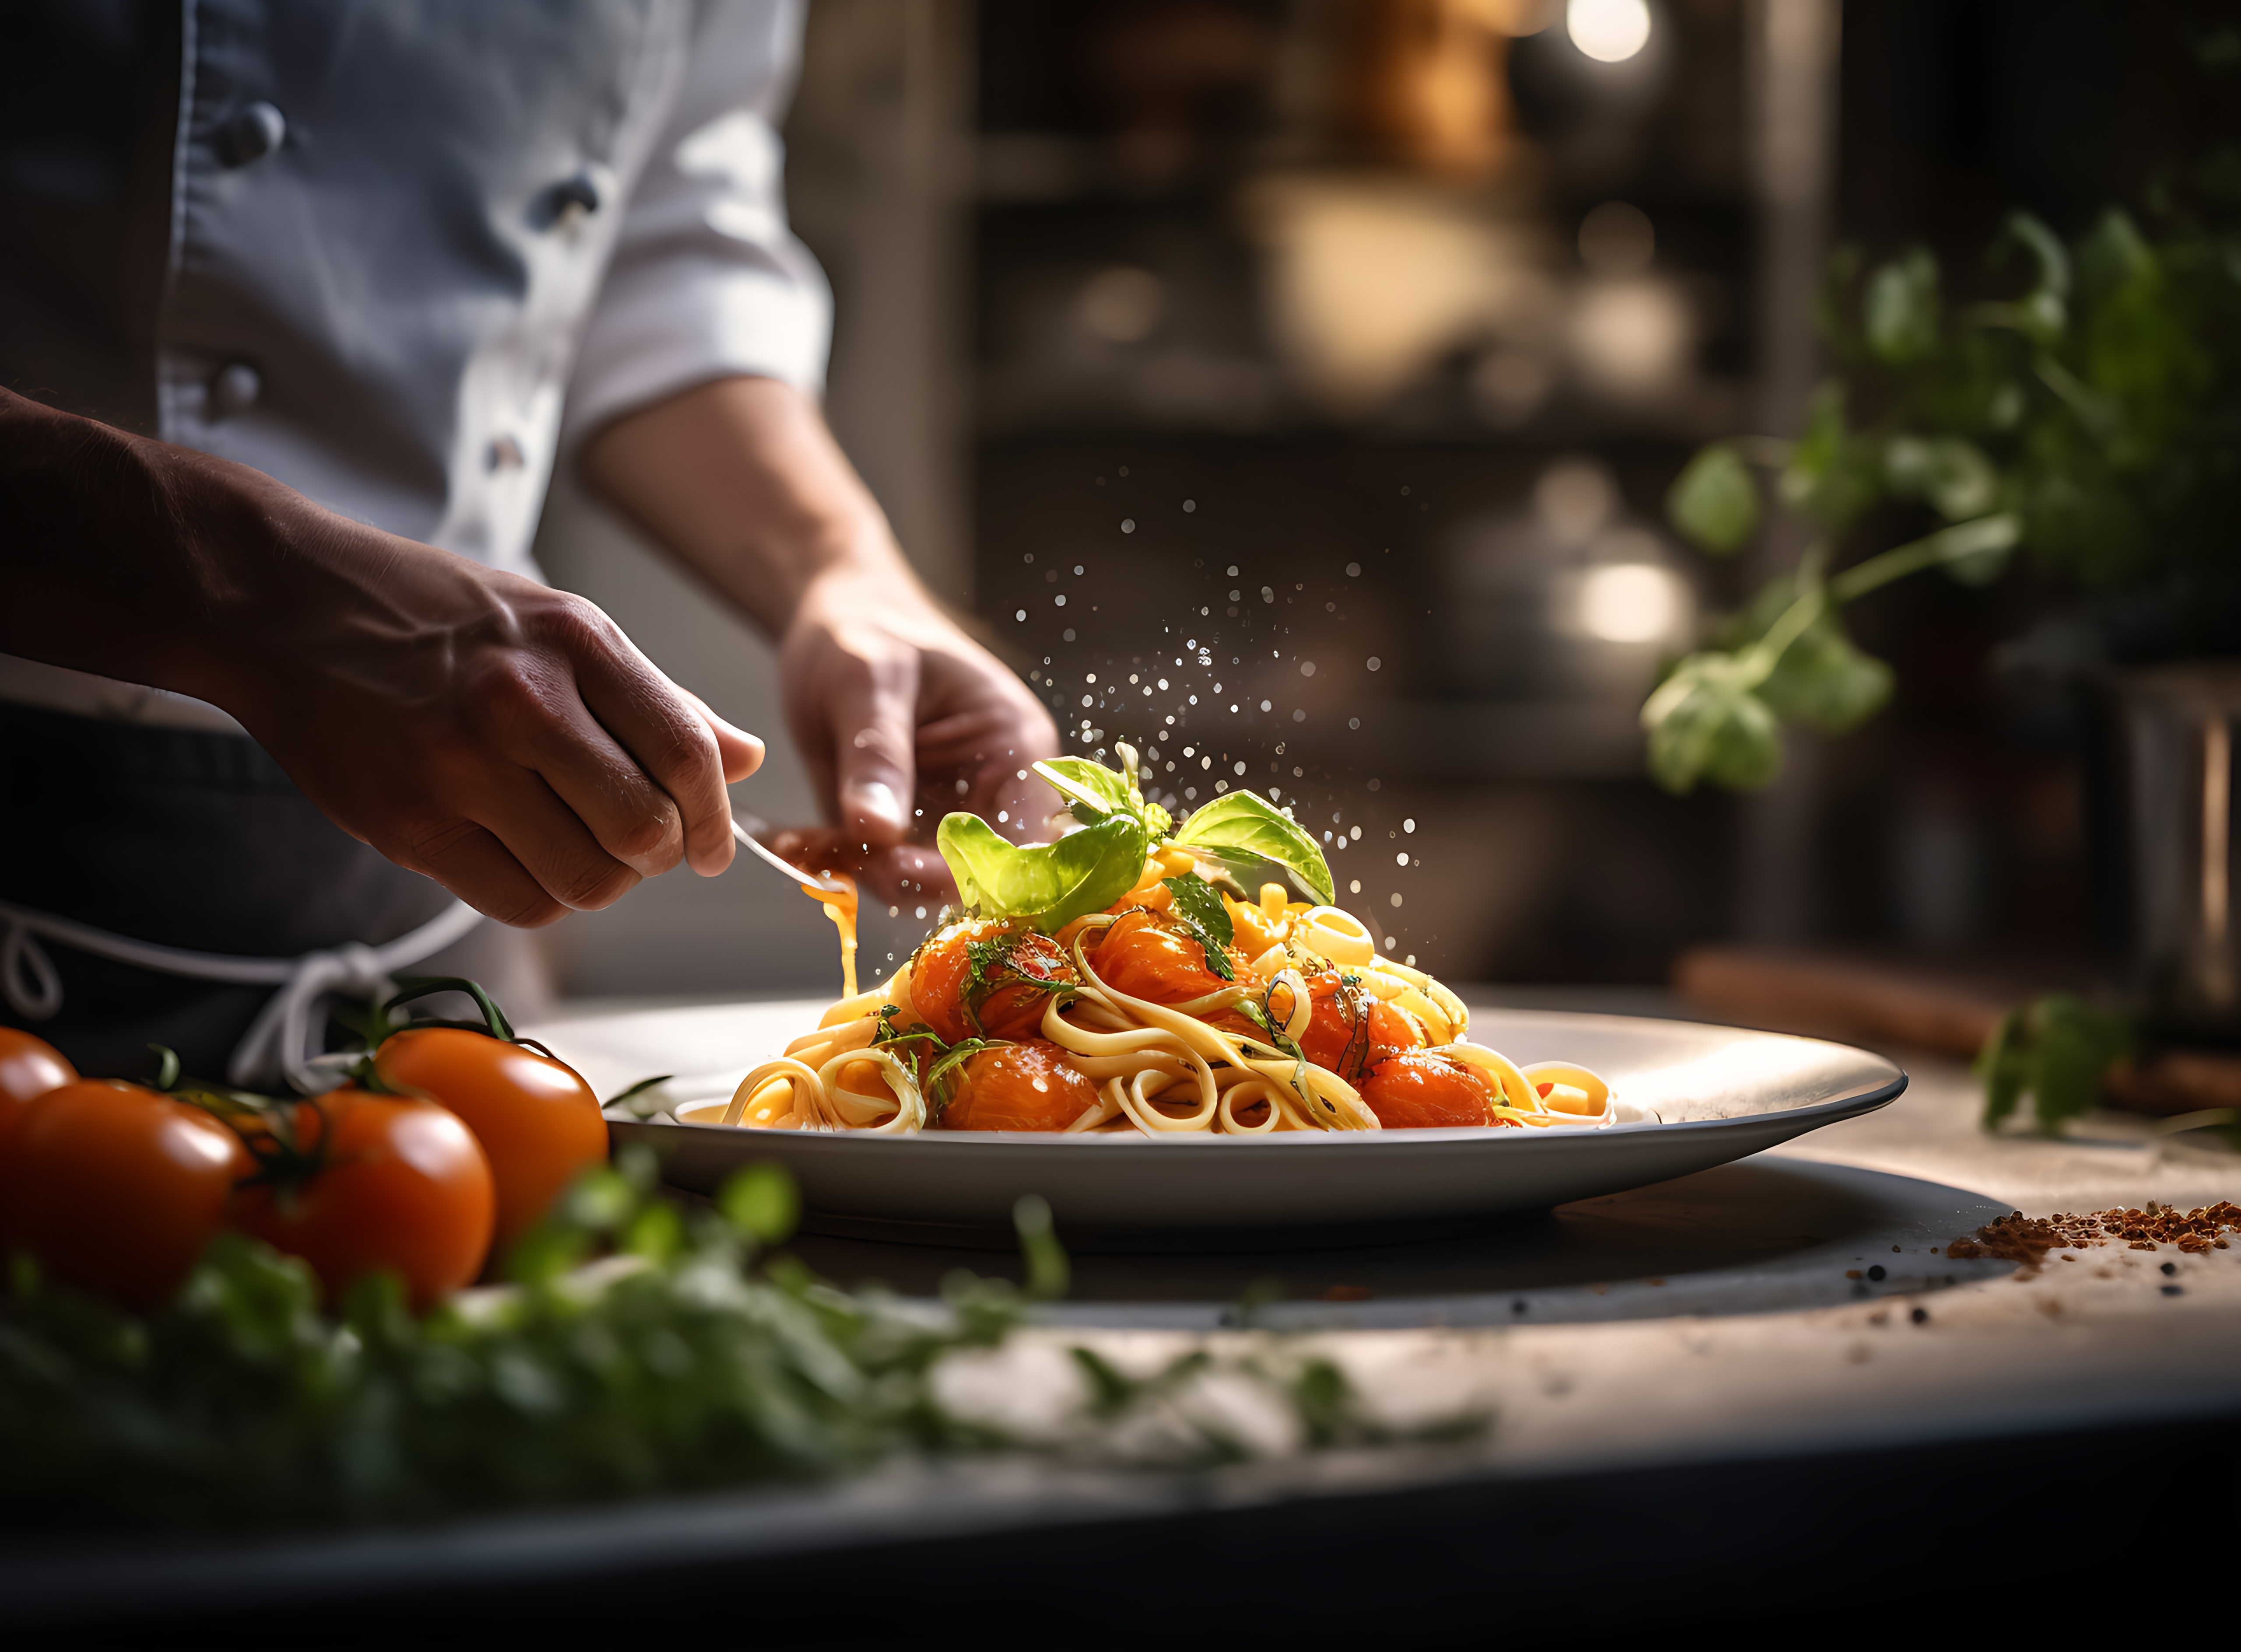
Introduction
The Recipe Finder is a website that helps you find recipes based on the ingredients you have at home. Just type in one or more ingredients, and you’ll get a list of tasty recipes you can make!
Users can save their favorite recipes and even modify them to suit their taste, making cooking a more enjoyable and personalized experience.
Recipe Finder
Notes:
Font Styles: Times New Roman + Font Size: 25

Slide 4
Literature Review
Existing Solutions:
Variety of Options: Numerous recipe apps are available, catering to specific cuisines and dietary needs (e.g., vegan, gluten-free).
Ingredient-Based Search: Many apps allow users to input available ingredients to find recipes, promoting efficient cooking.
User Challenges:
Limited Filtering: Most applications offer basic search options without advanced filtering for dietary preferences, cooking time, or skill level.
Lack of Personalization: Few platforms allow users to modify or save their favorite recipes for easy access
Notes:
Font Styles: Times New Roman + Font Size: 25

Slide 5
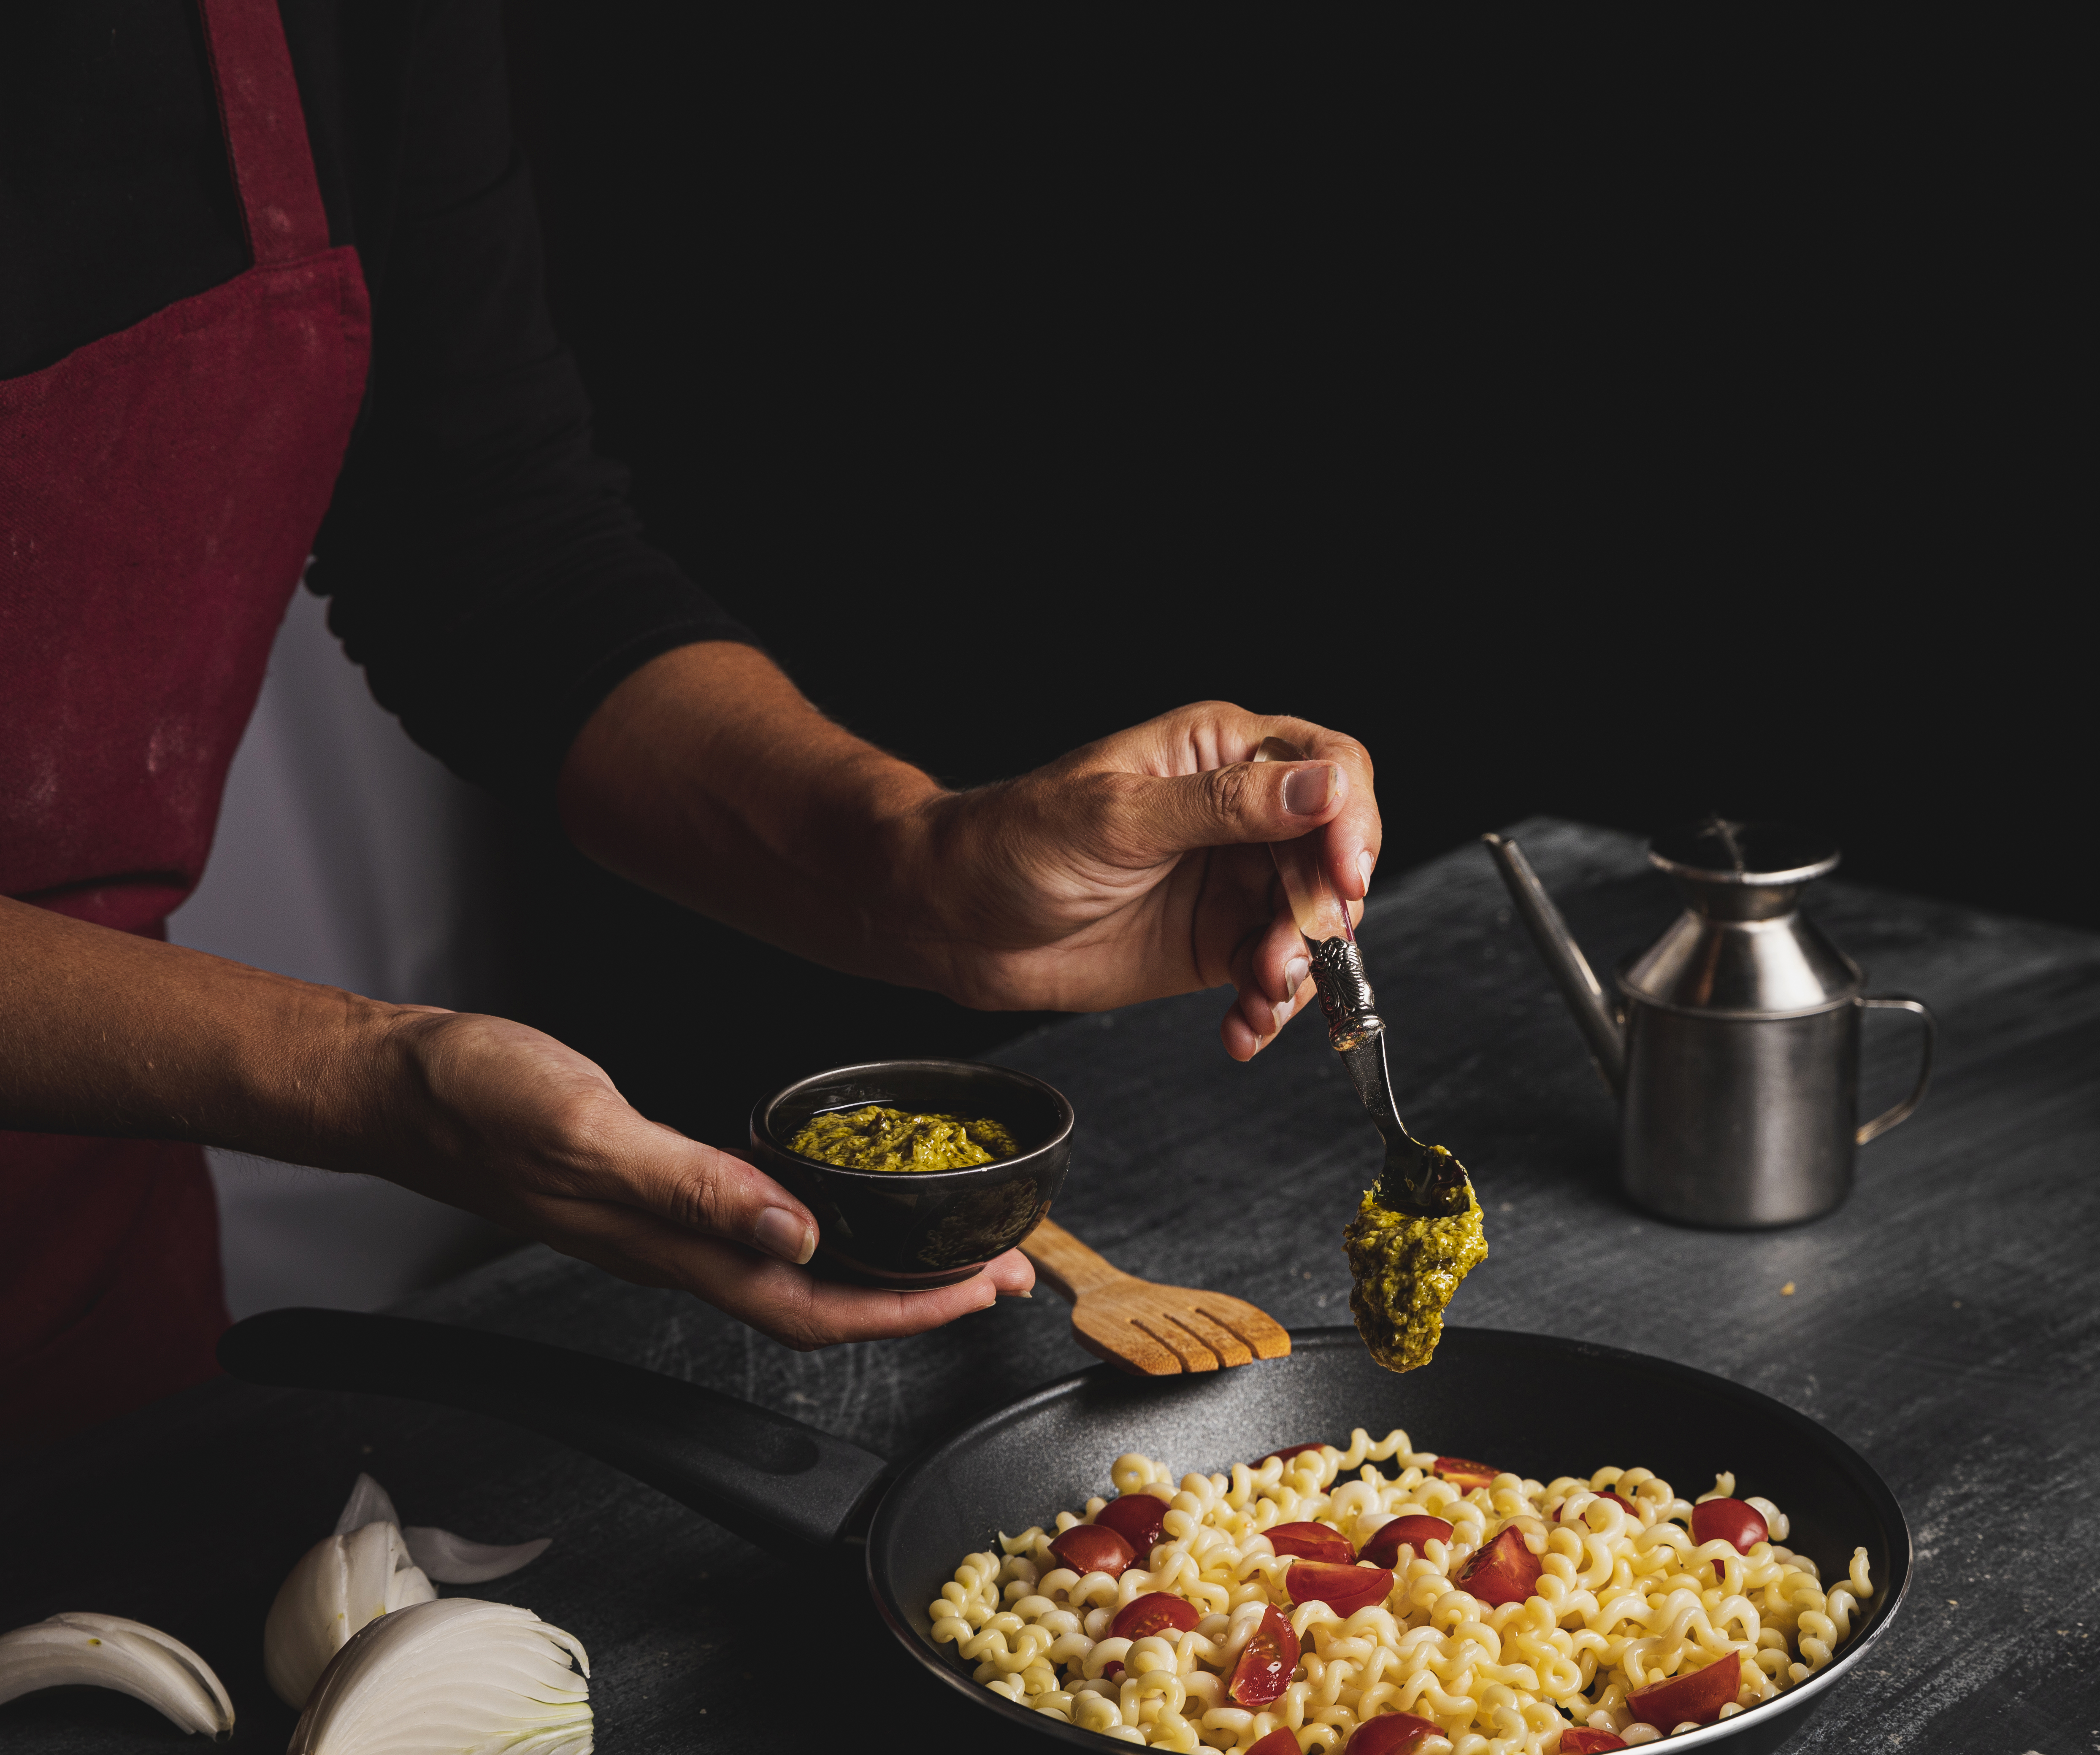
Literature Review (Contd.)
Identified Gaps:
User Experience: Limited research on user engagement and satisfaction with recipe finder applications; most apps lack intuitive designs.
Customization: Few applications provide extensive options for users to customize recipes based on taste, dietary restrictions, or available ingredients.
Importance of Recipe Finder:
Innovative Approach: The Recipe Finder addresses these gaps by offering a user-friendly interface and extensive customization options, enhancing user engagement and satisfaction.
Notes:
Font Styles: Times New Roman + Font Size: 25

Slide 6

Objective of the Project
Enhance User Experience: Create an intuitive and user-friendly interface that allows users to easily search for recipes based on available ingredients.
Promote Cooking at Home: Encourage users to cook more by providing a variety of recipes that utilize common ingredients, reducing food waste.
Facilitate Customization: Allow users to save their favorite recipes and customize them
Provide Comprehensive Filtering: Implement advanced search options to help users find recipes based on dietary preferences, preparation time.
Notes:
Font Styles: Times New Roman + Font Size: 25

Slide 7
Technology (Hardware Requirements)
Computer/Server:
Processor: Dual-core processor (e.g., Intel i3 or equivalent)
RAM: 4 GB or more
Storage: 500 MB of available disk space for application and data.
Development Environment:
Operating System: Windows, macOS, or Linux
Web Browser: Latest version of Chrome, Firefox, or Safari for testing.
Network:
Internet Connection: Stable internet connection for accessing APIs and hosting the application (if deployed online).
Notes:
Font Styles: Times New Roman + Font Size: 25

Slide 8
Technology (Software Requirements)
Backend:
Python: Programming language for the backend development.
Flask: Web framework for building the application.
SQLite/PostgreSQL: Database management system for storing recipe data.
Frontend:
HTML/CSS: For structuring and styling the web application.
JavaScript: For adding interactivity and handling user inputs.
Development Tools:
Code Editor: Visual Studio Code or any preferred code editor for writing code.
Version Control: Git for tracking changes and collaborating on the project.
Browser: Latest version of Chrome, Firefox, or Safari for testing the application.
Notes:
Font Styles: Times New Roman + Font Size: 25

Slide 9
Modules
User Interface Module:
Handles the layout and design of the web application.
Includes search bar, recipe display, and user interaction elements.
Recipe Management Module:
Manages recipe data, including retrieval, addition, and deletion of recipes.
Interacts with the database to store and fetch recipes based on user input.
Search Functionality Module:
Implements the logic for searching recipes by ingredients or names.
Provides advanced filtering options for dietary preferences and cooking time.
API Integration Module:
Connects with external recipe APIs to enhance the database with additional recipes.
Handles data fetching and integration into the application.
Notes:
Font Styles: Times New Roman + Font Size: 25

Slide 10
Workflow/Gantt Chart
User Input:
User enters ingredients or recipe name in the search bar.
Request ProcessiAng:
The frontend sends a request to the backend API with the search query.
Recipe Search:
The backend processes the request and searches the database for matching recipes.
Data Retrieval:
The backend retrieves relevant recipes and sends the data back to the frontend.
Display Results:
The frontend displays the list of matching recipes to the user, including details like ingredients and instructions.
Feedback Loop:
Users can provide feedback or ratings, which can be stored for future reference.
Notes:
Font Styles: Times New Roman + Font Size: 25

Slide 11
Reports
User Activity Report:
Tracks user interactions, including searches made and recipes viewed.
Helps understand user preferences and popular recipes.
Recipe Usage Report:
Analyzes which recipes are most frequently searched or saved by users.
Provides insights into trending ingredients and cooking styles.
Feedback and Ratings Report:
Compiles user feedback and ratings for recipes.
Identifies areas for improvement and highlights well-received recipes.
Notes:
Font Styles: Times New Roman + Font Size: 25

Slide 12
References
Online Tutorials:
Flask Documentation: flask.palletsprojects.com
W3Schools: w3schools.com for HTML, CSS, and JavaScript tutorials.
Research Papers:
"User Experience in Recipe Finder Applications" - Journal of Culinary Technology
"Enhancing Home Cooking through Digital Solutions" - International Journal of Food Science
APIs:
Spoonacular API: spoonacular.com for additional recipe data.
Development Tools:
Visual Studio Code: code.visualstudio.com
Git Documentation: git-scm.com
Notes:
Font Styles: Times New Roman + Font Size: 25

